Slide 1
MODULE 3
NETWORK LAYER

Slide 2
Network Layer Services, Packet Switching, Network Layer Performance, IPv4 Addressing (classful and classless), Subnetting, Super netting ,IPv4 Protocol, DHCP, Network Address Translation (NAT).
Routing algorithms: Distance Vector Routing, Link state routing, Path Vector Routing. Protocols –RIP,OSPF,BGP. Next Generation IP: IPv6 Addressing,IPv6 Protocol, Transition fromIPV4 to IPV6

Slide 3
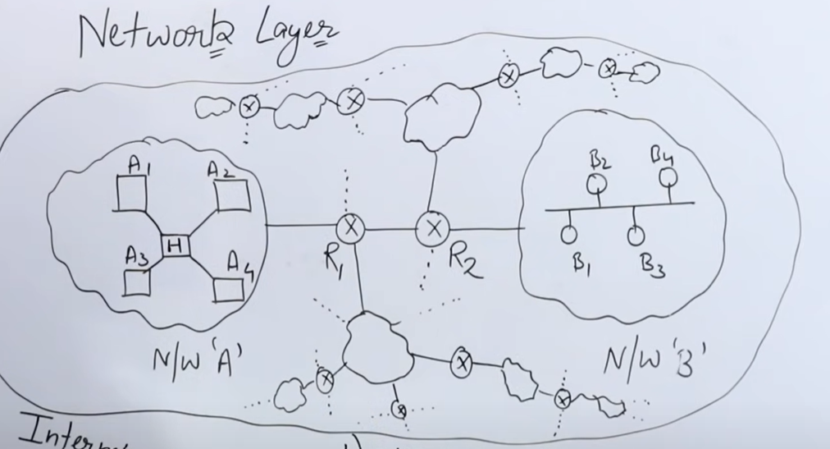

Slide 4
Network Layer Services
It’s main function is to transfer network packets from the source to the destination.
It is involved both at the source host and the destination host. At the source, it accepts a packet from the transport layer, encapsulates it in a datagram and then deliver the packet to the data link layer so that it can further be sent to the receiver.
At the destination, the datagram is decapsulated, the packet is extracted and delivered to the corresponding transport layer.

Slide 5
Features :
Main responsibility of Network layer is to carry the data packets from the source to the destination without changing or using it.
If the packets are too large for delivery, they are fragmented i.e., broken down into smaller packets.
It decides the route to be taken by the packets to travel from the source to the destination among the multiple routes available in a network (also called as routing).
The source and destination addresses are added to the data packets inside the network layer

Slide 6
The services which are offered by the network layer protocol are as follows:
Packetizing – The process of encapsulating the data received from upper layers of the network(also called as payload) in a network layer packet at the source and decapsulating the payload from the network layer packet at the destination is known as packetizing.
The source host adds a header that contains the source and destination address and some other relevant information required by the network layer protocol to the payload received from the upper layer protocol, and delivers the packet to the data link layer.
The destination host receives the network layer packet from its data link layer, decapsulates the packet, and delivers the payload to the corresponding upper layer protocol. The routers in the path are not allowed to change either the source or the destination address. The routers in the path are not allowed to decapsulate the packets they receive unless they need to be fragmented.

Slide 7
Routing and Forwarding – These are two other services offered by the network layer.
In a network, there are a number of routes available from the source to the destination. The network layer specifies has some strategies which find out the best possible route. This process is referred to as routing. There are a number of routing protocols which are used in this process and they should be run to help the routers coordinate with each other and help in establishing communication throughout the network.
Forwarding is simply defined as the action applied by each router when a packet arrives at one of its interfaces. When a router receives a packet from one of its attached networks, it needs to forward the packet to another attached network

Slide 8
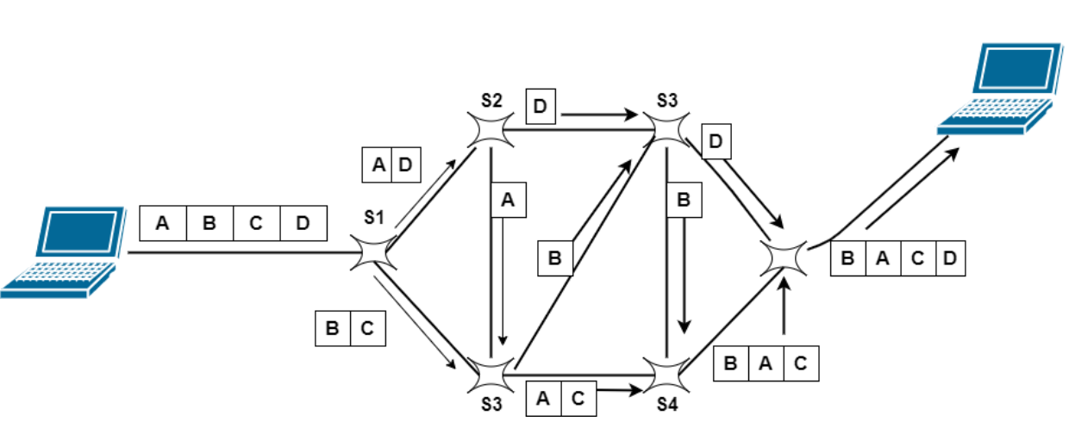
Packet switching

Slide 9
Packet Switching is a technique of switching in which the message is usually divided into smaller pieces that are known as packets.
Every packet contains a header that contains the knowledge of the destination. With the help of this knowledge/information, these packets find the route.
A unique number is given to each packet in order to identify them at the receiving end.
One of the biggest examples of the Packet-switched network is the Internet.
The header of the Packet mainly comprises of two things: header and payload.
where the header mainly contains the routing information.
and the payload contains the data that is to be transferred.

Slide 10
This switching is also based on the store and forward method.
In the Packet Switched network, there is no resource reservation, and resources are allocated on demand.
As we know that each packet contains the information of source and destination in their headers. Thus all packets can independently travel in the network.
Packets related to the same file might take different paths and it mainly depends upon the availability of the path. These packets will be then re-assembled at the destination. It is the responsibility of the receiver node to re-arrange the received packet in order to get the original data.
The message of acknowledgment will be sent by the receiver if packets reach the receiver in the correct order.
In case of a missing packet or corrupted packet, the message will be sent by the receiver to the sender to resend the message.

Slide 11
Two different approaches used for Packet switching are as follows:
Datagram Packet Switching
Virtual Circuit Switching

Slide 12
Datagram Packet Switching
In Datagram Switching, the packet is commonly known as a datagram. Datagram Packet switching is also known as Connectionless Packet Switching. In this technique, each packet routed individually by network devices on the basis of the destination address that is contained within each packet.
Each packet is basically treated independently of all others.
Datagram packet switching is done at the network layer.
This is Connectionless packet switching because the packet switch does not keep the information about the connection state.
In the Datagram packet switching the path is not fixed.

Slide 13
Routing decisions are taken by the intermediate nodes in order to forward the packets.
Thus all datagrams that belong to the same message may travel through different paths in order to reach their destination.
On the receiving node, all the packets are reassembled to get the message in the original form.
Due to lack of resources packets may also be lost or dropped.
In most of the protocols, it is the responsibility of the upper-layer protocol to reorder the datagrams or to ask for the lost datagrams before passing them on to the application.

Slide 14
Virtual Circuit Switching
Virtual Circuit Switching is also known as Connection-Oriented Switching. This switching contains the characteristics of circuit switching as well as datagram packet switching. In this type of packet switching the data-packets are first assembled and then sequentially numbered. Now they are ready to travel across a predefined route, sequentially. The information about the address is not required here, because all the data packets are sent in sequence.

Slide 15
The resource allocation is done during the setup phase like it is done in the circuit-switched network or it can be done on demand like in datagram networks.
The data is in the form of packets like the datagram network and also each packet carries the destination address in the header.
Like the circuit-switched network, all packets in the Virtual network follows the same path that is established during the connection.
This switching is normally implemented in the data link layer.

Slide 16
Advantages of Packet Switching
Given below are some benefits of the Packet Switching:
More efficient utilization of bandwidth.
Latency in the transmission is minimum in packet switching.
This technique is cheaper to implement and thus it is cost-effective.
The same channel can be used by many users simultaneously.
As there are improved protocols, thus packet switching is used by many applications like Skype, WhatsApp, etc.
The fault tolerance in this technique is more in case of any link down because packets may follow different paths.
This technique is more reliable than other techniques because it can easily detect missing packets.

Slide 17
Disadvantages of Packet Switching
Some of the drawbacks of Packet Switching are as follows:
This technique cannot be used by those applications that cannot afford more delays like applications of high-quality voice calls.
Protocols used in this technique are complex and thus their implementation cost is high.
In the case of an overloaded network, the packet may get lost or there might occur delay which causes the loss of critical information.
On the receiver's side sorting of the packets sent by the sender is required.

Slide 18
Performance of a Network
Performance of a network pertains to the measure of service quality of a network as perceived by the user. There are different ways to measure the performance of a network, depending upon the nature and design of the network. The characteristics that measure the performance of a network are :
Bandwidth
Throughput
Latency (Delay)
Bandwidth – Delay Product
Jitter

Slide 19
BANDWIDTH
Bandwidth is characterized as the measure of data or information that can be transmitted in a fixed measure of time. The term can be used in two different contexts with two distinctive estimating values. In the case of digital devices, the bandwidth is measured in bits per second(bps) or bytes per second. In the case of analogue devices, the bandwidth is measured in cycles per second, or Hertz (Hz).
“Bandwidth” means “Capacity” and “Speed” means “Transfer rate”.

Slide 20
Bandwidth in Hertz: It is the range of frequencies contained in a composite signal or the range of frequencies a channel can pass. For example, let us consider the bandwidth of a subscriber telephone line as 4 kHz.
Bandwidth in Bits per Seconds: It refers to the number of bits per second that a channel, a link, or rather a network can transmit. For example, we can say the bandwidth of a Fast Ethernet network is a maximum of 100 Mbps, which means that the network can send 100 Mbps of data.

Slide 21
THROUGHPUT Throughput is the number of messages successfully transmitted per unit time. It is controlled by available bandwidth, the available signal-to-noise ratio and hardware limitations. The maximum throughput of a network may be consequently higher than the actual throughput achieved in everyday consumption. The terms ‘throughput’ and ‘bandwidth’ are often thought of as the same, yet they are different. Bandwidth is the potential measurement of a link, whereas throughput is an actual measurement of how fast we can send data.

Slide 22
LATENCY In a network, during the process of data communication, latency(also known as delay) is defined as the total time taken for a complete message to arrive at the destination, starting with the time when the first bit of the message is sent out from the source and ending with the time when the last bit of the message is delivered at the destination. The network connections where small delays occur are called “Low-Latency-Networks” and the network connections which suffer from long delays are known as “High-Latency-Networks”.
Latency = Propagation Time + Transmission Time + Queuing Time + Processing Delay

Slide 23
Propagation Time: It is the time required for a bit to travel from the source to the destination
Transmission Time: Transmission time is a time based on how long it takes to send the signal down the transmission line.
Queuing Time: Queuing time is a time based on how long the packet has to sit around in the router. Quite frequently the wire is busy, so we are not able to transmit a packet immediately. The queuing time is usually not a fixed factor, hence it changes with the load thrust in the network. In cases like these, the packet sits waiting, ready to go, in a queue. These delays are predominantly characterized by the measure of traffic on the system. The more the traffic, the more likely a packet is stuck in the queue, just sitting in the memory, waiting.

Slide 24
Processing Delay: Processing delay is the delay based on how long it takes the router to figure out where to send the packet. As soon as the router finds it out, it will queue the packet for transmission. These costs are predominantly based on the complexity of the protocol.
JITTER Jitter is another performance issue related to delay. In technical terms, jitter is a “packet delay variance”. It can simply mean that jitter is considered as a problem when different packets of data face different delays in a network

Slide 25
IPv4 is responsible for packetizing, forwarding, and delivery of a packet.
ICMPv4 helps IPv4 to handle some errors that may occur in delivery.
IGMP is used to help IPv4 in multicasting.
ARP is used in network layer address to link layer mapping

Slide 26
IPv4
The Internet protocol offers a best-effort service of delivering datagrams between hosts.
IPv4 is a connectionless internet protocol for packet switched network
IPv4 datagrams may be lost, arbitrarily delayed, corrupted, or duplicated.
Needs to be paired with TCP for reliability.

Slide 27
IPv4 Datagram Format
Packets used by IP are called datagrams.
A datagram is a variable-length packet consisting of two parts:
Header
payload (data)
The header is 20 to 60 bytes in length and contains information essential to routing and delivery.

Slide 28
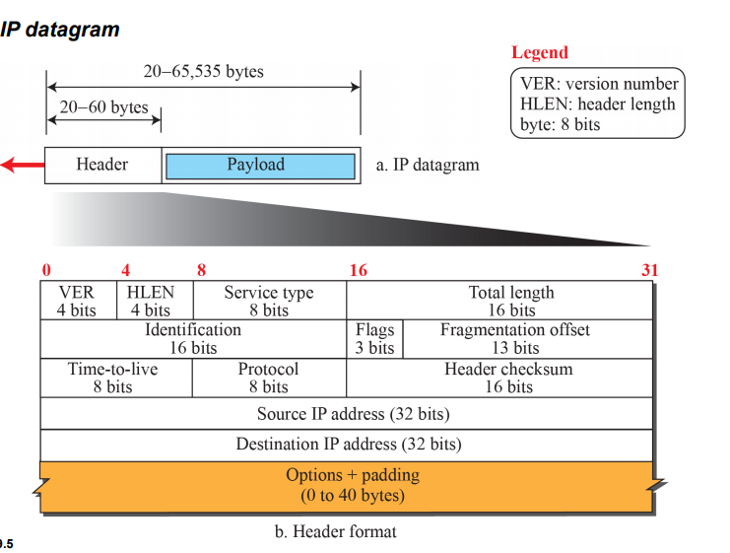

Slide 29
Version
Version of the IP protocol which determines how to interpret the header. Currently the only permitted values are 4 (0100) or 6 (0110). The header format shown here is valid for IPv4 only.
HLEN
Length of header as a number of 32-bit words
Type of service
This field is often ignored by current routers but is meant to allow traffic to be prioritised (among other things).
Total Length
The length of the entire datagram including header and data: maximum permitted it 65,535 bytes or 64K
Identification, Flags and Fragment Offset
These values allow datagrams to be fragmented for transmission and reassembled at the destination

Slide 30
Time to live
An integer which is decremented at each router "hop"; supposed to be interpreted as a number of seconds but more often treated as a "hop count". If the value reaches zero the datagram is discarded and an ICMP message is sent to the source host.
Protocol
Identifies the transport-layer protocol which will interpret the Data section. This will typically be TCP or UDP but other values are possible. Protocols are identified by a unique number

Slide 31
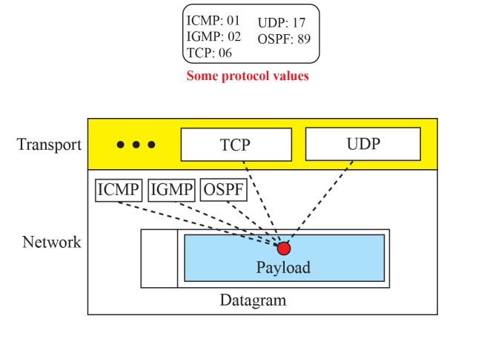
Multiplexing and demultiplexing using the value of the protocol field
Protocol plays the same role as the ports play in transport layer

Slide 32
Header checksum
This is used to verify the header, and is recomputed at each router hop. This field is left out of IPv6 which relies on the transport layer for verification.
Addresses and Options
These are 32-bit IP addresses which identify the network and host address. Note that IP does not have to specify addresses of any intermediate nodes; this can be left to the router. Routing requirements can also be specified in the Options field, along with options to do with security and debugging.

Slide 33
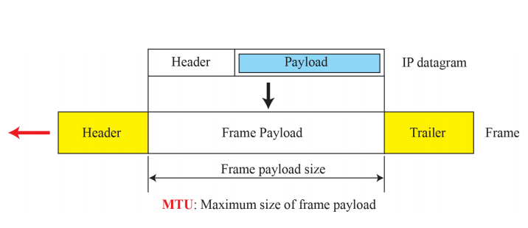
Fragmentation
The format and size of the sent frame depend on the protocol used by the physical network through which the frame is going to travel.
For example, if a router connects a LAN to a WAN, it receives a frame in the LAN format and sends a frame in the WAN format.
Maximum transfer unit (MTU)
Max size of the payload that can be encapsulated
Size of datagram < max size, else fragmented

Slide 34
A datagram can be fragmented by the source host or any router in the path.
When a datagram is fragmented, each fragment has its own header with most of the fields repeated, but some have been changed.
The reassembly of the datagram, however, is done only by the destination host, because each fragment becomes an independent datagram.

Slide 35
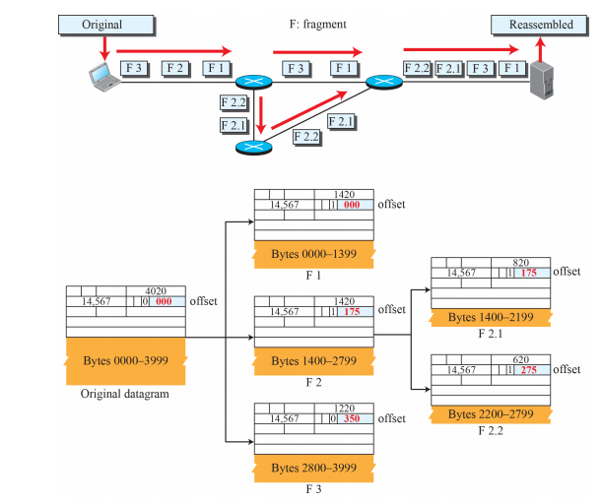
Example

Slide 36
Logical Addressing
we need a global addressing scheme; we called this logical addressing
term IP address to mean a logical address in the network layer
Version popularly in use IPv4 (IP version 4)
IPv4 Internet addresses are 32 bits in length
this gives us a maximum of 2³² addresses.
The need for more addresses, in addition to other concerns about the IP layer, motivated a new design of the IP layer called the new generation of IP or IPv6 (lP version 6).
IPv6 uses 128-bit addresses that give much greater flexibility in address allocation.

Slide 37
IPv4 Addresses
IPv4 addresses are universal.
An IPv4 address is 32 bits long.
IPv4 addresses are unique / dynamic also possible
IP is the address of the connection and not the host or router
Every host would have an Unique address for every connection
Address Space
total number of addresses used by the protocol
If a protocol uses N bits to define an address, the address space is 2^{N}
IPv4 uses 32-bit addresses, which means that the address space is 2³² or 4,294,967,296 (minus few)

Slide 38
Notations
There are two prevalent notations to show an IPv4 address:
binary notation ( base 2)
Dotted decimal notation. ( base 256)
Hexadecimal notation ( base 16)
Binary Notation
is displayed as 32 bits.
Each octet is often referred to as a byte. So it is common to hear an IPv4 address referred to as a 32-bit address or a 4-byte address.
The following is an example of an IPv4 address in binary notation:
01110101 10010101 00011101 00000010

Slide 39
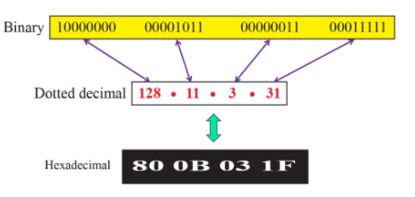
Dotted-Decimal Notation
To make the IPv4 address more compact and easier to read
Internet addresses are usually written in decimal form with a decimal point (dot) separating the bytes.
The following is the dotted-decimal notation of the above address:
117.149.29.2
Hexadecimal Notation
4 bit

Slide 40
Identify valid IP address?
172.16.254.1
256.5.254.2

Slide 41
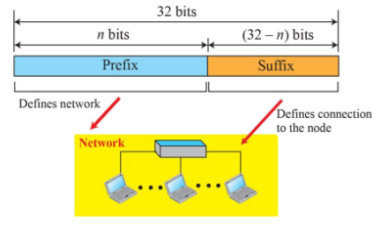
Hierarchy in Addressing
32 bit IPv4 is hierarchical
Divided into 2 parts :
prefix - defines the network
- length is n bits
- fixed ( classfull) or variable
length ( classless)
Suffix – defines the node
- length is 32-n bits

Slide 42
Classful Addressing
•Devices examines the first octet of the address and determines the address range.
• The high order bits never change for each class.
• For instance in Classful Addressing:
• 192.168.23.2 is in the Class C range
• Therefore – 24 network bits and 8 hosts bits.
The subnet mask allows networks to be subdivided or subnetted.
• Each class is assigned a default subnet mask.

Slide 43
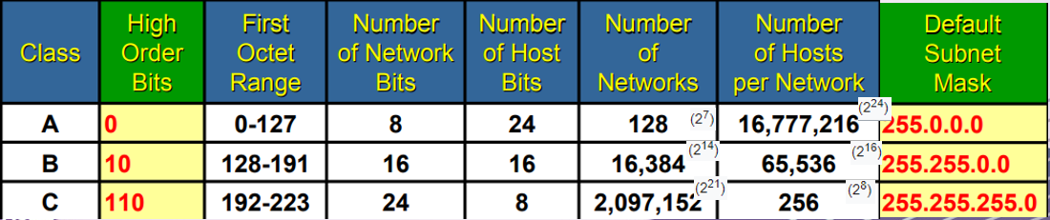

Slide 44
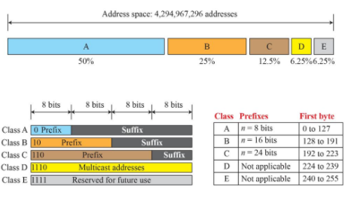
Fixed length prefix ( 3 fixed length prefixes are designed n=8,16,24)
Address space is divided into 5 classes ( A,B,C,D,E)
occupation address space in classful addressing

Slide 45
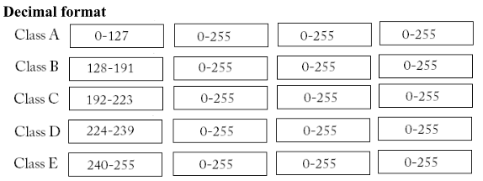
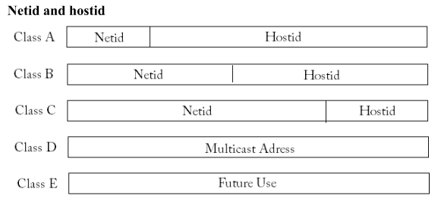

Slide 46
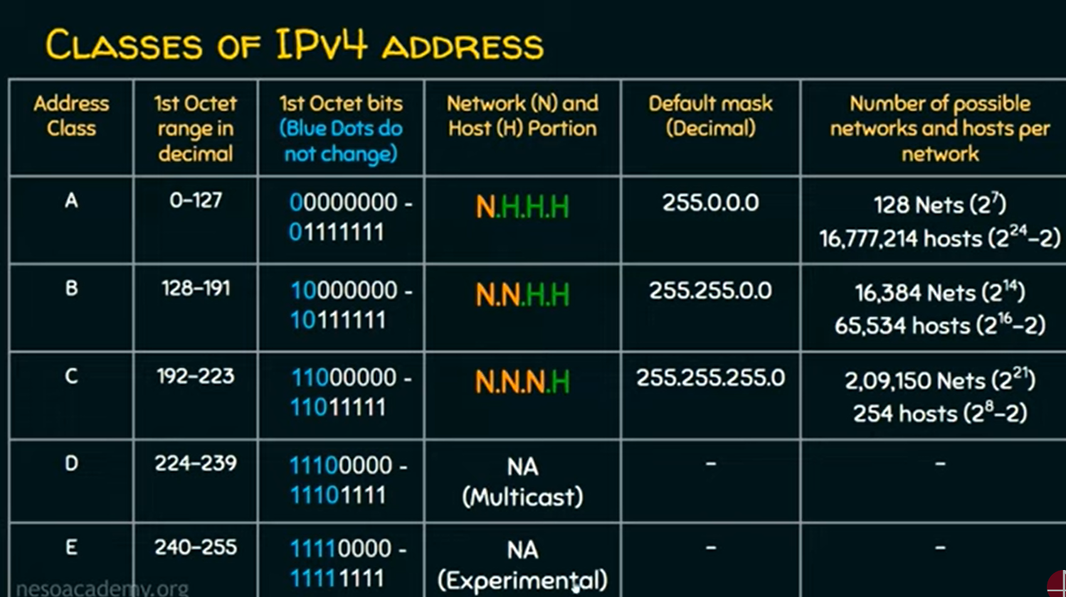

Slide 47
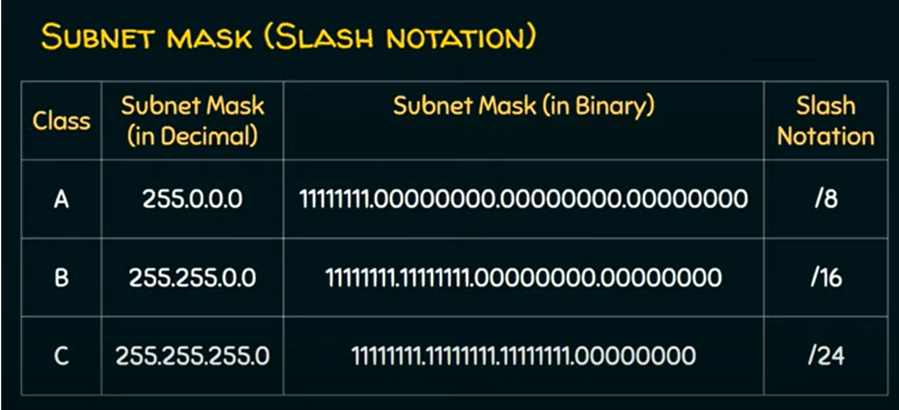

Slide 48
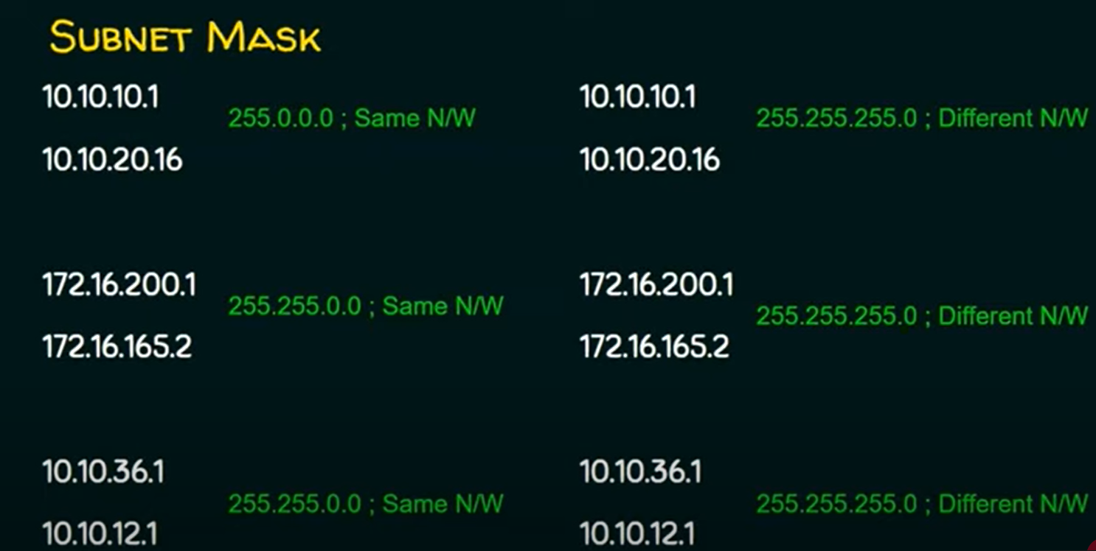

Slide 49
Class A
contained all addresses in which the most significant bit is zero.
The network number for this class is given by the next 7 bits, therefore accommodating 128 networks in total, including the zero network, and including the IP networks already allocated.
Class B
network was a network in which all addresses had the two most-significant bits set to 10
For these networks, the network address was given by the next 14 bits of the address
leaving 16 bits for numbering host on the network
total of 65536 addresses per network.
Class C
3 high-order bits/ most-significant bits are set to 110
designating the next 21 bits to number the networks
leaving each network with 256 local addresses.

Slide 50
In order to function properly with network devices, every IP network must contain three types of addresses:
Network Address:
All HOST BITS are set to 0.
Host Address:
HOST BITS will vary.
Broadcast Address:
All HOST BITS are set to 1.
For a host to communicate directly with another host on the same network, they must have the same network portion.

Slide 51
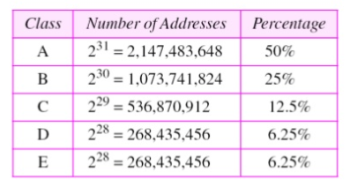
Addresses per class

Slide 52
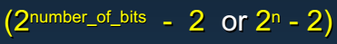
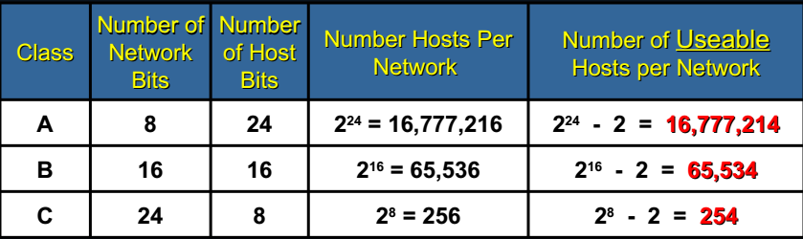
For every IP address range that we assign to a network segment, we automatically lose two addresses….
One for the network address (sometimes called the wire address or subnetwork address)
One for the broadcast address for that network.

Slide 53
Problems
Ip address: 134.35.78.2
Class: B
Netid bits:2 Byte Netid : 134.35
Network address: 134.35.0.0
Default Subnet mask : 255.255.0.0
TRY
1.The network address: 17.0.0.0.
Find i) the Block ( net id) ii) the range of addresses.
2. The network address : 132.21.0.0.
Find i) the Block ii) the range of addresses.
3. Given the network address 220.34.76.0
Find i) the Block ii) the range of addresses.
4. The given IP address is 23.56.7.91. find the network address.

Slide 54
Solution
The class is A because the first byte is between 0 and 127. The block has a netid of 17. The addresses range from 17.0.0.0 to 17.255.255.255.
The class is B because the first byte is between 128 and 191. The block has a netid of 132.21. The addresses range from 132.21.0.0 to 132.21.255.255.
The class is C because the first byte is between 192 and 223. The block has a netid of 220.34.76. The addresses range from 220.34.76.0 to 220.34.76.255.
The default mask is 255.0.0.0, which means that only the first byte is preserved and the other 3 bytes are set to 0s. The network address is 23.0.0.0.
Notes:
More Problems : https://www.slideshare.net/gauravkoriya1989/ip-address-1831634
https://users.cs.jmu.edu/aboutams/Web/Networking/Spring03/Lectures/Lecture%203-%20IP%20Classful%20Addressing.pdf

Slide 55
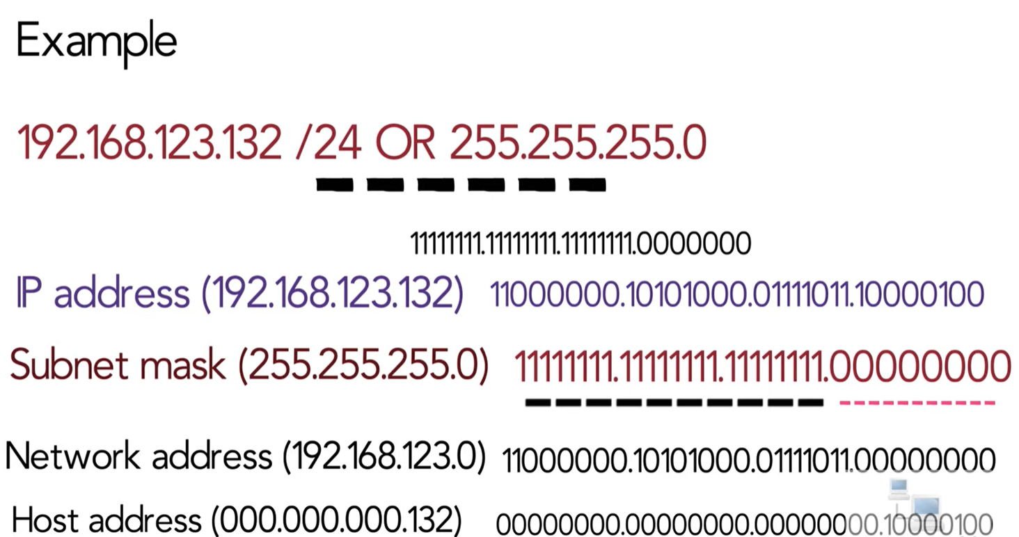

Slide 56
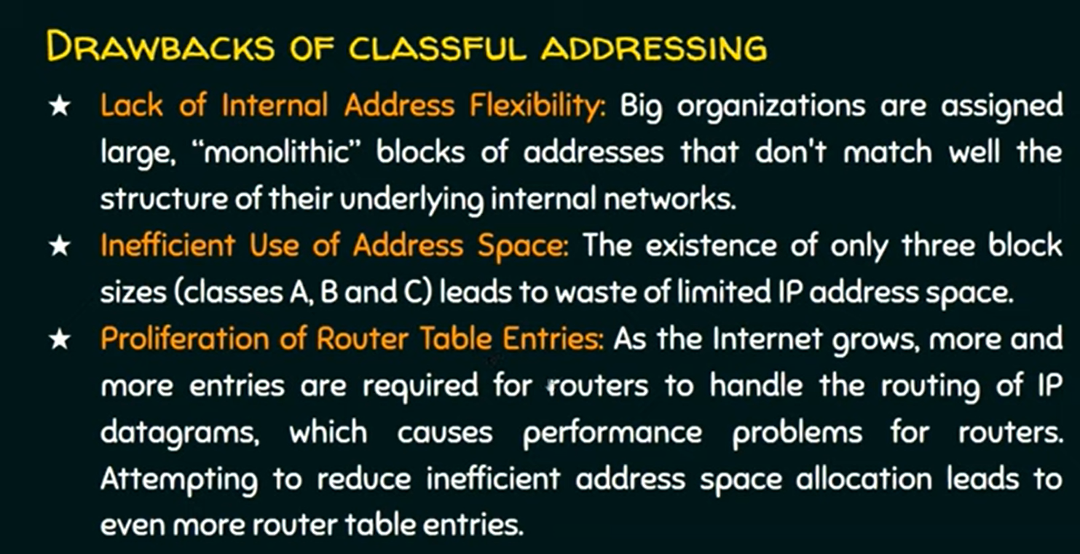

Slide 57
Ip address shows who u r
Subnet mask shows who r ur neighbour

Slide 58
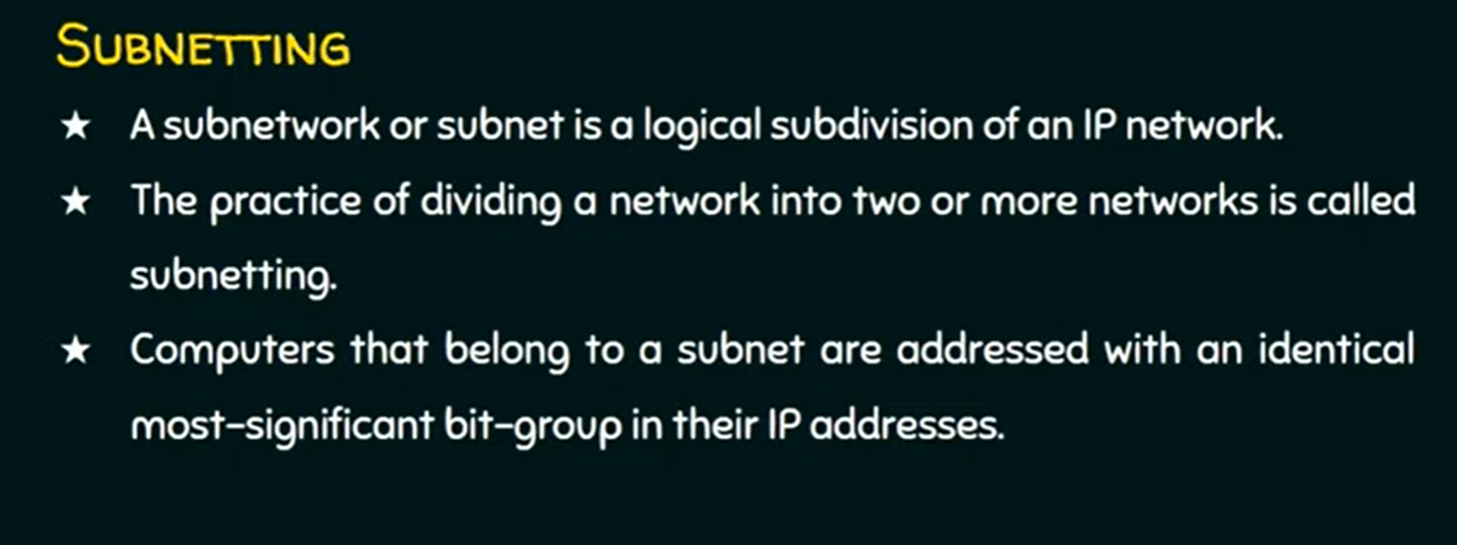
Subnetting

Slide 59
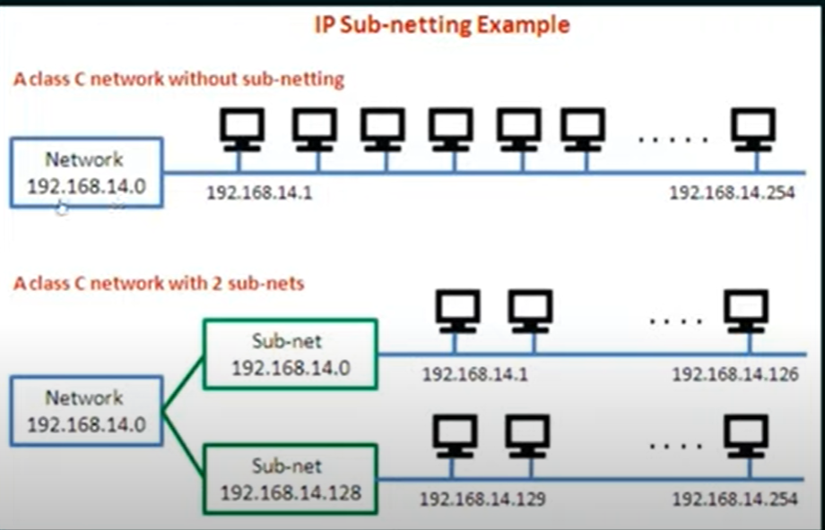

Slide 60
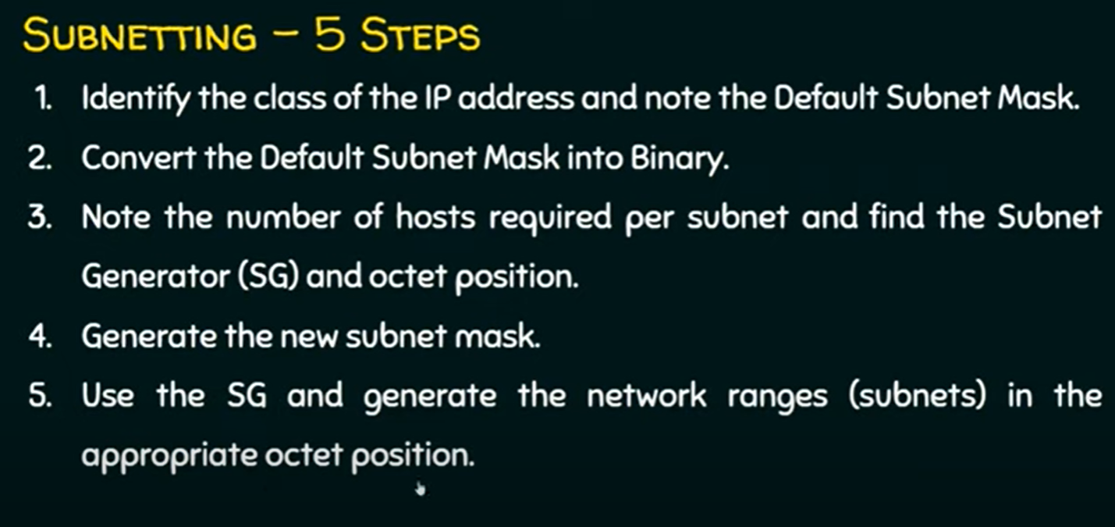

Slide 61
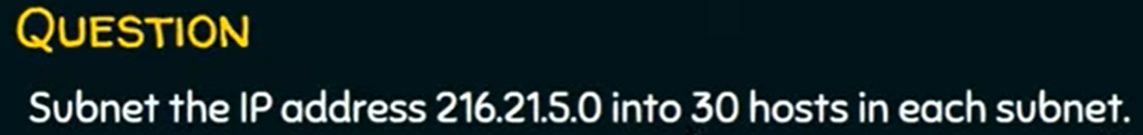

Slide 62
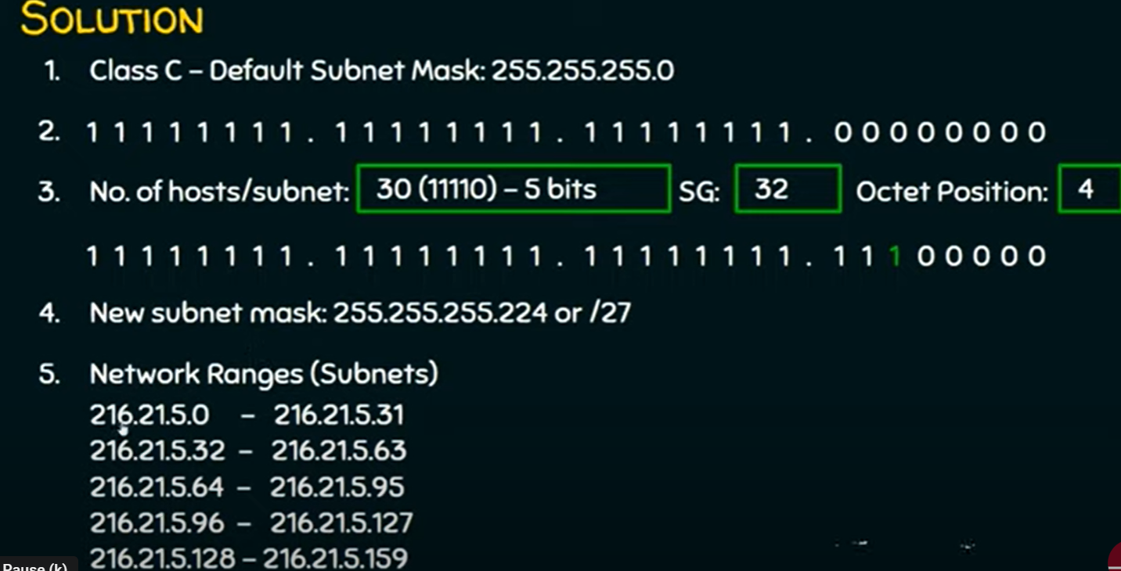

Slide 63
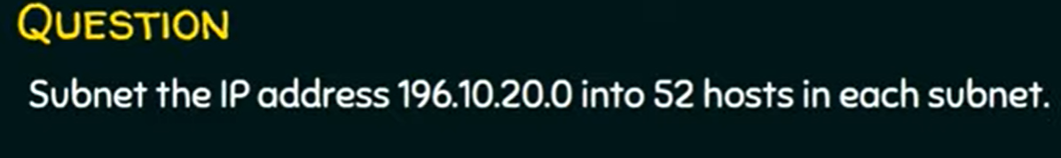

Slide 64
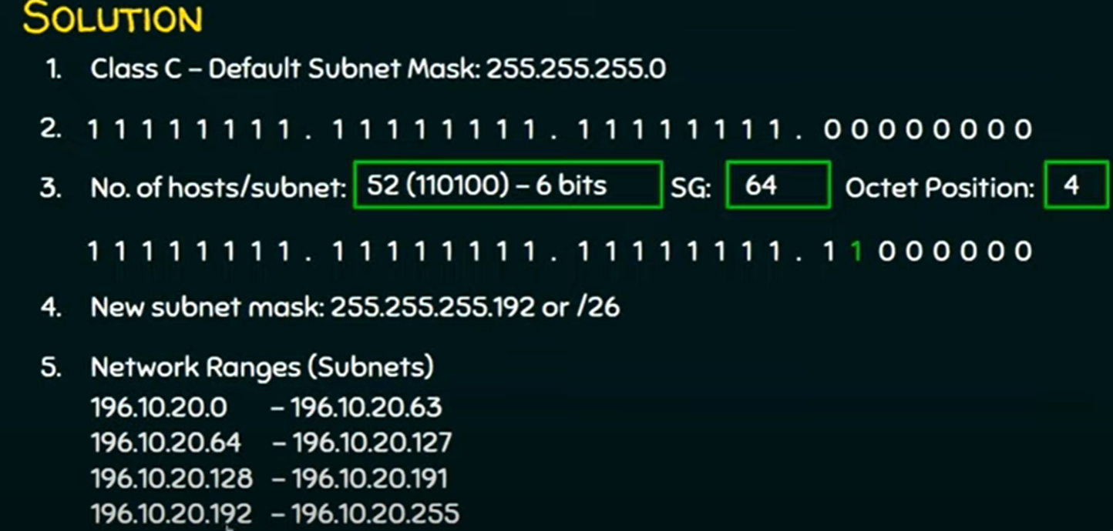

Slide 65
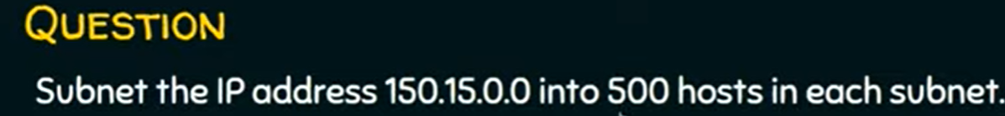

Slide 66
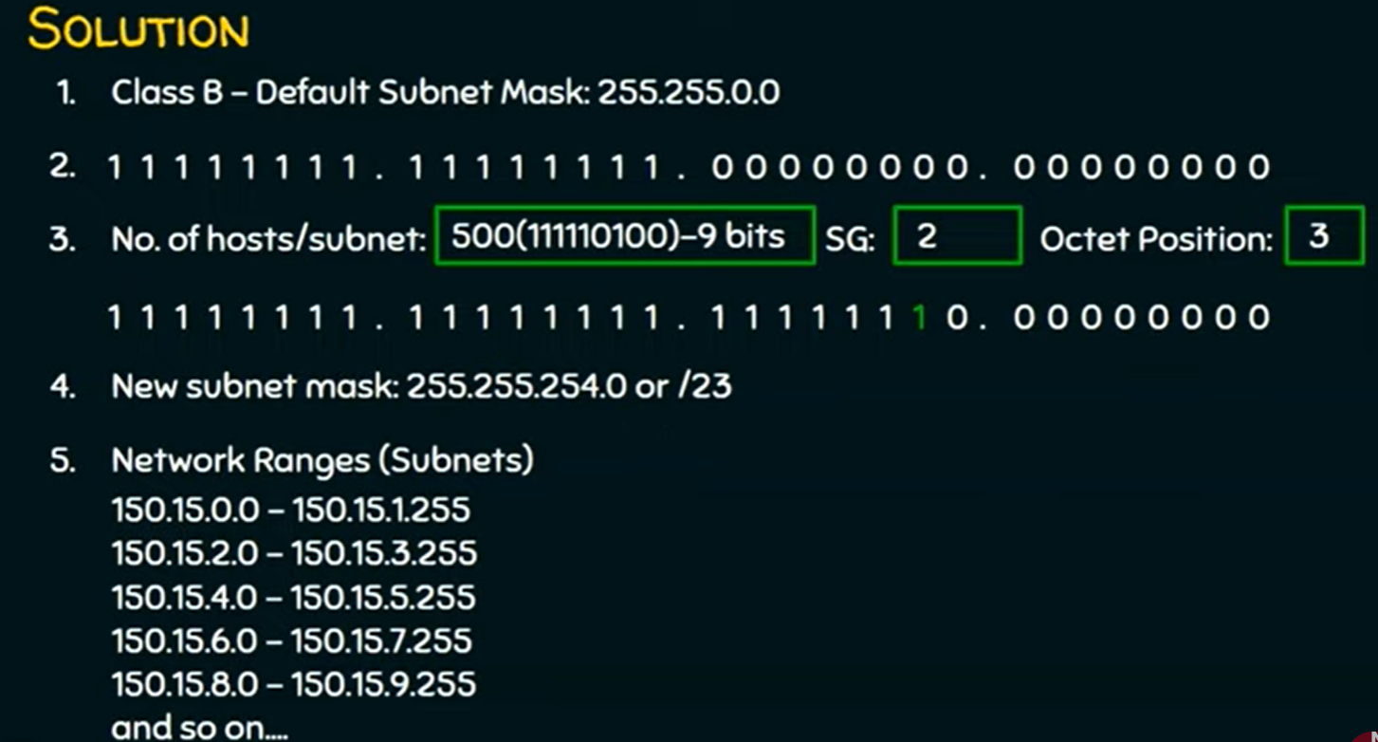

Slide 67
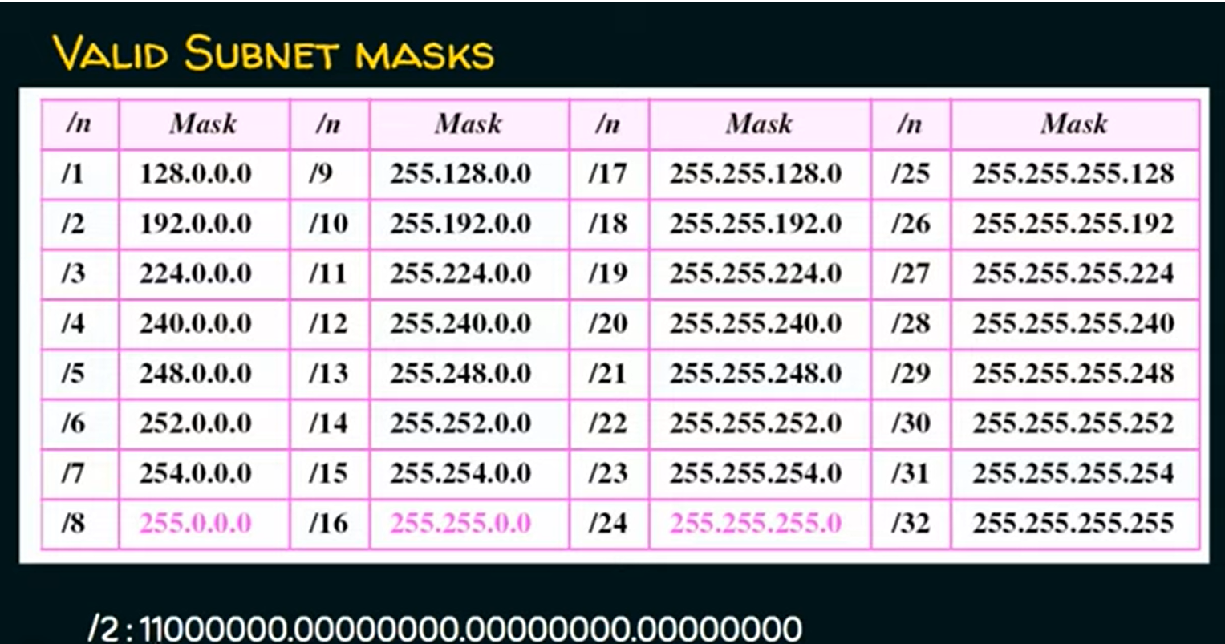

Slide 68
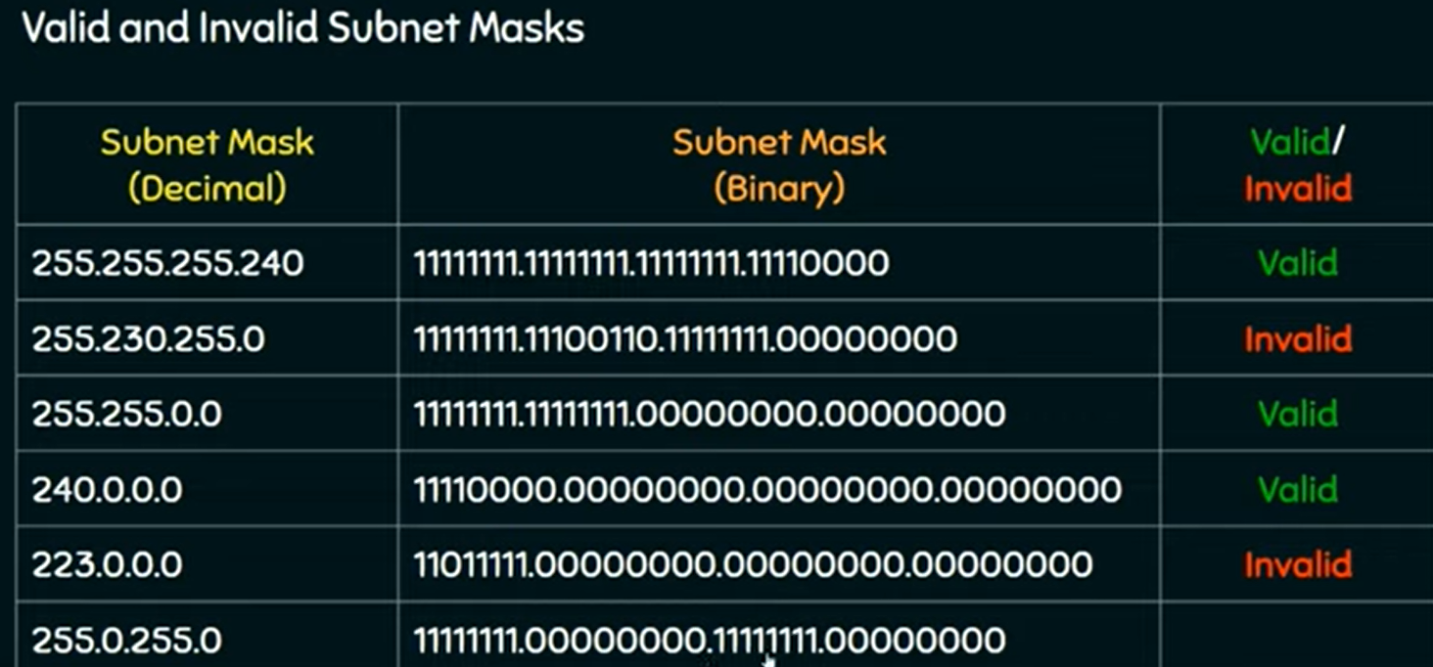

Slide 69
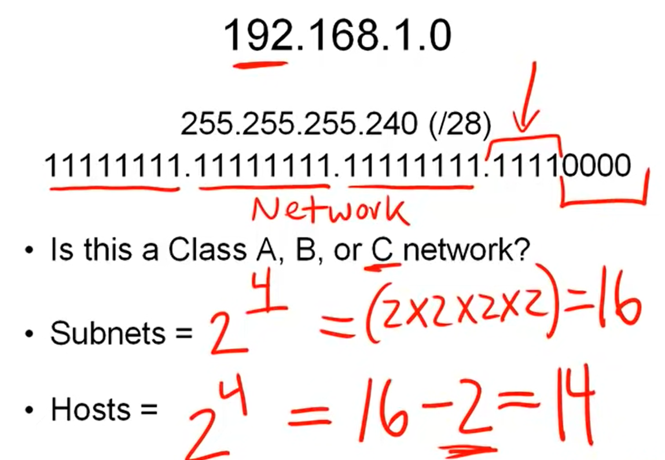
Number of subnets and valid host

Slide 70
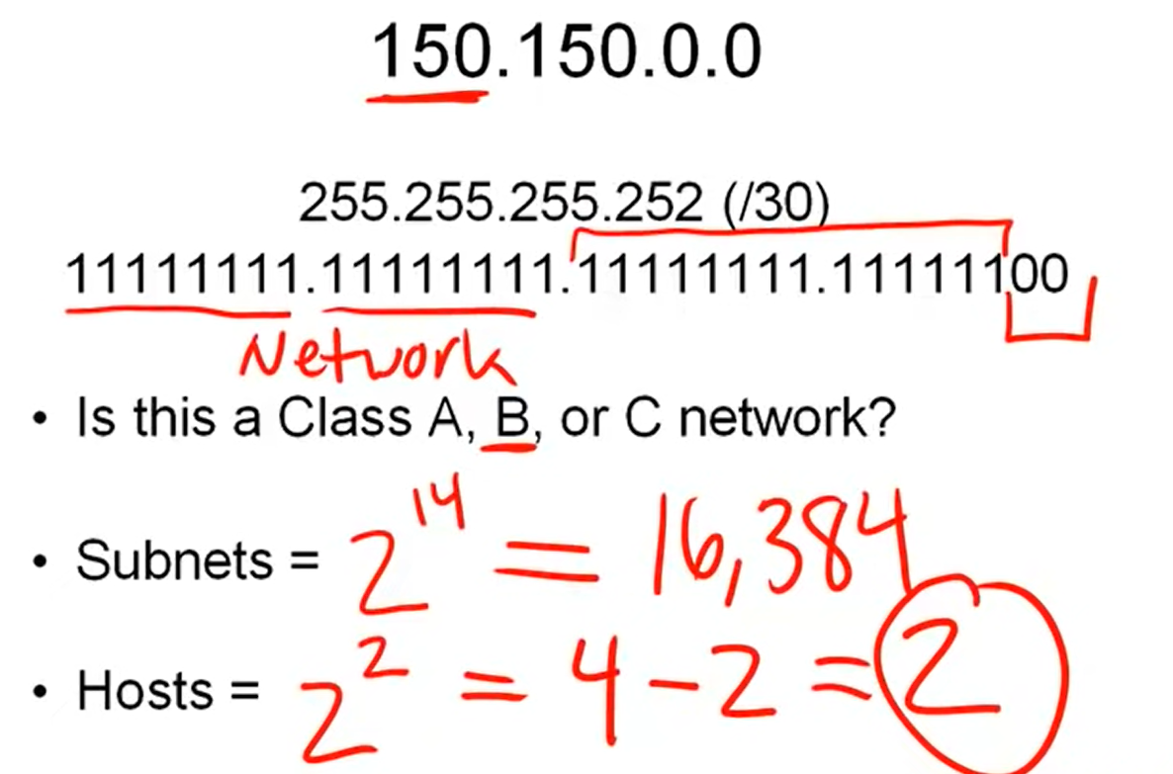

Slide 71
Super netting
Why Super-netting
Suppose an organization is started with 250 hosts now they need to increase the No. of hosts to 500 then they can use 2 class C blocks ie., super-netting.
Conditions for super-netting:
The No. of blocks must be a power of 2.
The blocks must be contiguous in the address space
The 3rd byte of the 1st address in the super block must be evenly divisible by the number of blocks.

Slide 72
Class less addressing
Classless Addressing is also called the slash notation or CIDR notation (Classless Inter-Domain Routing)
In IPv4 Classless addressing, a block of addresses can be defined as
x.y.z.t /n in which x.y.z.t defines one of the addresses and the /n defines the mask.
Mask is a 32-bit number in which the n leftmost bits are 1s and the 32 - n rightmost bits are 0s
Example 1:
What is the network address if one of the addresses is 167.199.170.82/27?

Slide 73
The prefix length is 27
We must keep the first 27 bits as it is and change the remaining bits (5) to 0s.
The 5 bits affect only the last byte.
The last byte is 01010010.
Changing the last 5 bits to 0s, we get 01000000 or 64.
The network address is 167.199.170.64/27

Slide 74
Example 2:
A block of addresses is granted to a small organization. We know that one of the addresses is 205.16.37.39/28. What is the first address in the block?
Solution
The binary representation of the given address is
11001101 00010000 00100101 00100111
If we set 32−29 rightmost bits to 0, we get
11001101 00010000 00100101 00100000
or 205.16.37.32.

Slide 75
Example 3:
Find the last address for the block 205.16.37.39/28
Solution
The binary representation of the given address is
11001101 00010000 00100101 00100111
If we set 32 − 29 rightmost bits to 1, we get
11001101 00010000 00100101 00101111
or
205.16.37.47

Slide 76
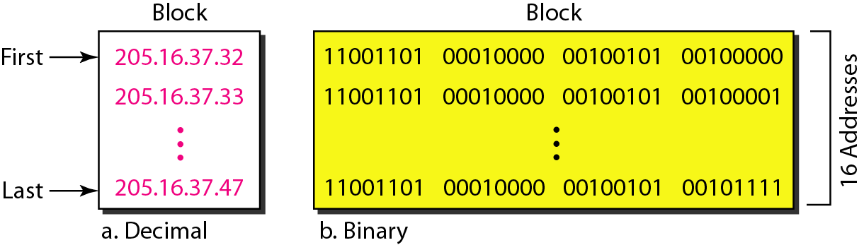

Slide 77
DHCP protocol
DHCP is an application layer program, client/server model helping TCP/IP in network layer
DHCP uses UDP well know ports 67 on server and 68 on client
Need a way to simply connect a computer to a new network – No manual configuration
DHCP provides dynamic configuration – Client can get a temporary address, and move from network to network
DHCP can do static and dynamic address allocation that can be manual or automatic.
Static Address Allocation
DHCP server has a database that statically binds physical addresses to IP addresses.
Dynamic Address Allocation
dynamically assigns IP addresses to hosts from a pool of available IP addresses.
When a DHCP client sends a request to a DHCP server, the server first checks its static database. If an entry with the requested physical address exists in the static database, the permanent IP address of the client is returned.

Slide 78
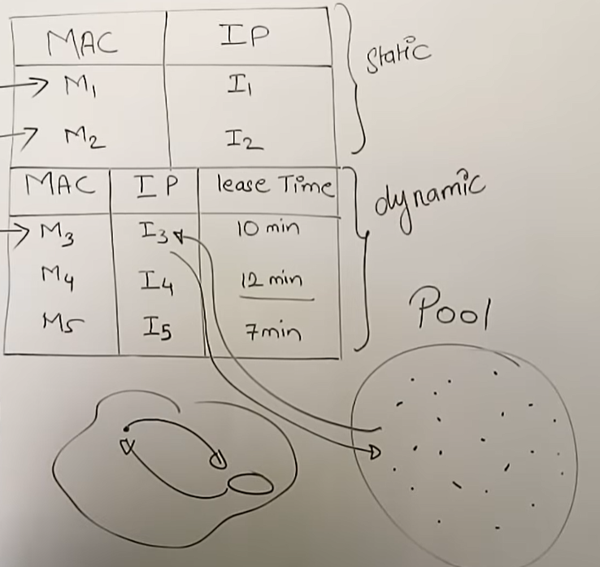

Slide 79
On the other hand, if the entry does not exist in the static database, the server selects an IP address from the available pool, assigns the address to the client, and adds the entry to the dynamic database.
DHCP provides temporary IP addresses for a limited period of time.
The dynamic aspect of DHCP is needed when a host moves from network to network or is connected and disconnected from a network frequently

Slide 80
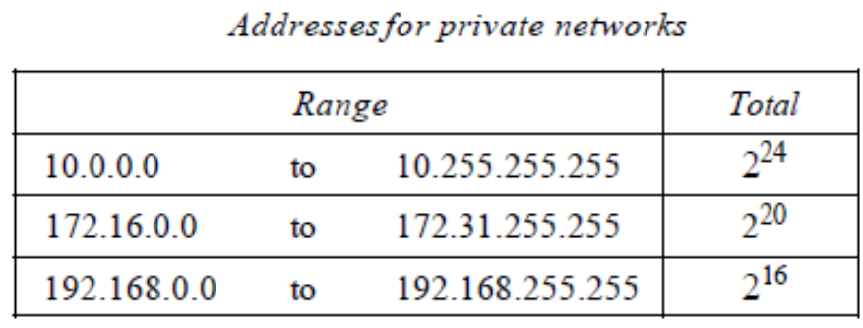
Network Address translation ( NAT)
number of users increasing, there is shortage of addresses
A quick solution to this problem is called network address translation (NAT).
NAT enables a user to have a large set of addresses internally and one address, or a smallset of addresses, externally.
reserved three sets of addresses as private addresses

Slide 81
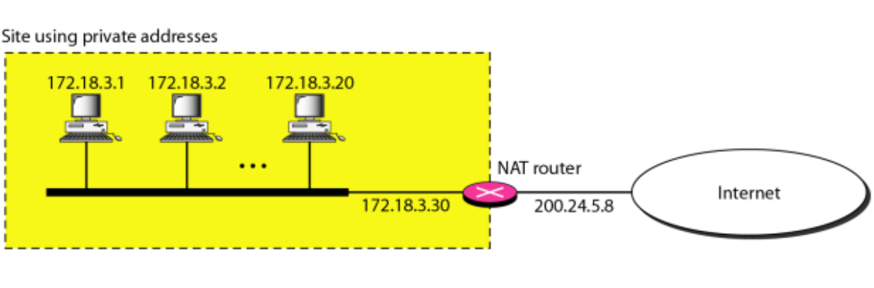
Everyone knows that these reserved addresses are for private networks.
They are unique inside the organization, but they are not unique globally.
No router will forward a packet that has one of these addresses
The router that connects the network to the global address uses one private address and one global address.

Slide 82
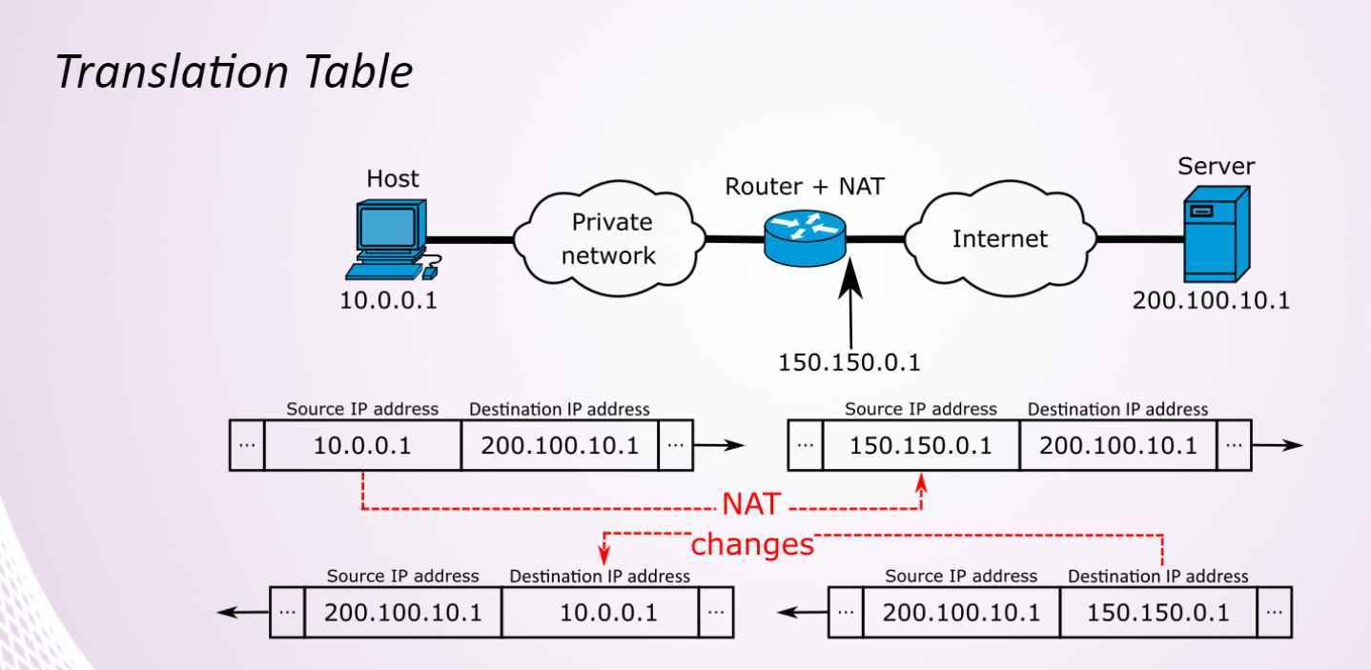

Slide 83
Routing algorithm
find reachable destinations
find best paths towards destinations
best in the sense of some metric - shortest path,number of hops, delay, congestion
Routing methods can be classified as
Static/ Dynamic Routing
Intra/ Inter domain Routing
Static Routing
Also referred as Non-Adaptive Routing
Manual: follows user defined routing and routing table is not changed until network administrator changes it.
simple routing algorithms
more security than dynamic routing.
implemented in smaller networks.
Dynamic Routing
Also referred as Adaptive Routing
routing table changes once changes occur in network nor network topology changes

Slide 84
During network change, dynamic routing sends a signal to router, recalculates the routes and send the updated routing information.
less secure
Automatic
implemented in large networks
Intra Domain Routing
works only within domains,need to know only about other routers within their domain/ Autonomous System (AS).
Also called as Interior-gateway protocols (IGP).
Inter Domain Routing
Routing algorithm works within and between domains, needs to know only about other routers within and between their domain
Also called as Exterior-gateway protocols (EGP).

Slide 85
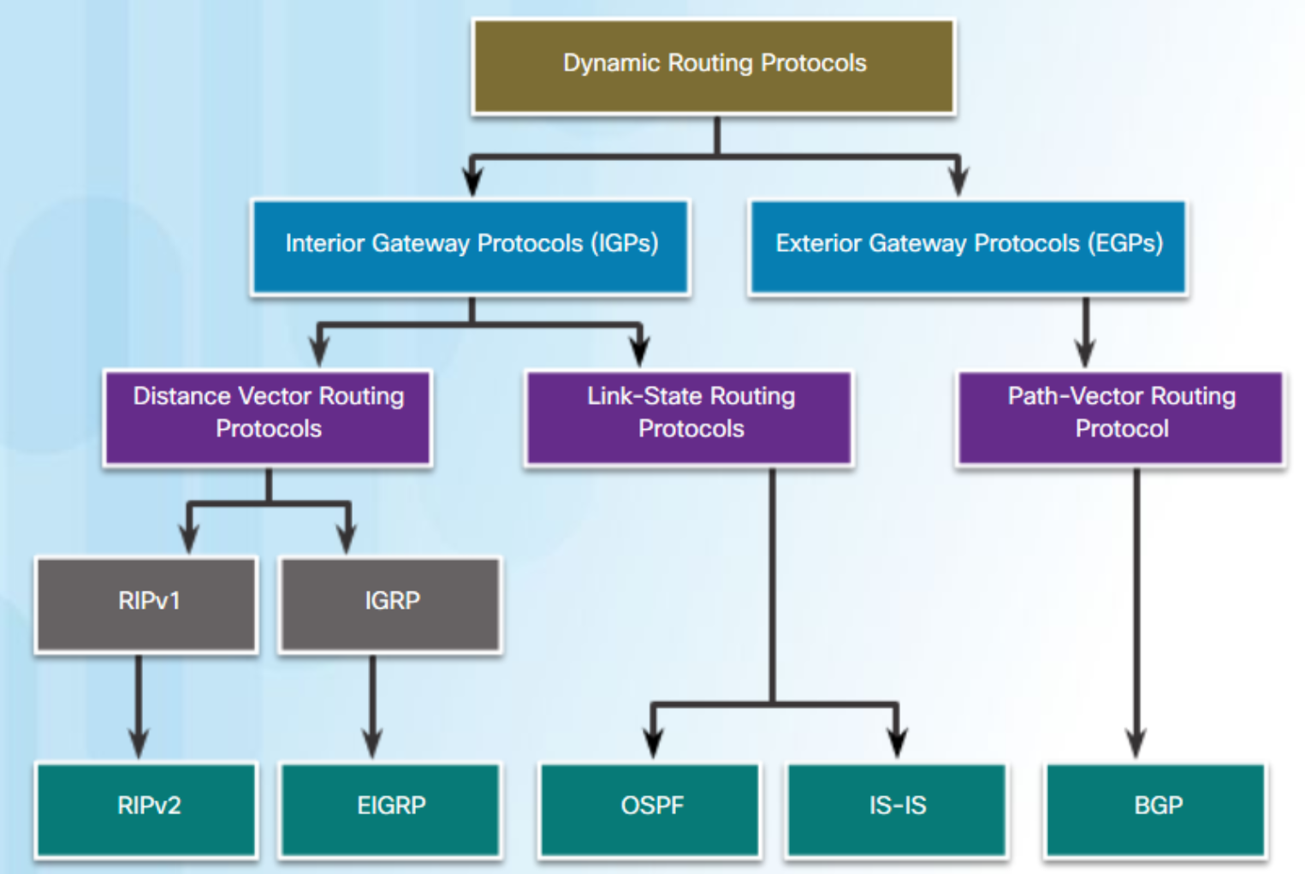

Slide 86
Distance Vector Algorithm
Iterative, distributive and Dynamic Routing technique
Used in internet as RIP ( Routing Information Protocol)
based on Bellman-Ford equation
Initially,
given nodes know the distance to all it’s neighbours
Finally,
Distance to all other nodes is know, with the next hop

Slide 87
Each router maintains Routing Table (Distance Vector) which contains
Destination
Cost to destination
Next hop to reach destination
Each node exchanges with all its neighbours (ONLY) “Routing Table” info
Destination and Estimated cost to the destination
No hop info is not shared

Slide 88
Each node exchanges with its neighbours (ONLY) DV
destination and current distance
Not next hop
The neighbour on receiving the Routing table, it updates its own DV using B-F equation:
the estimate Dx(y) converge to the actual least cost dx(y)

Slide 89
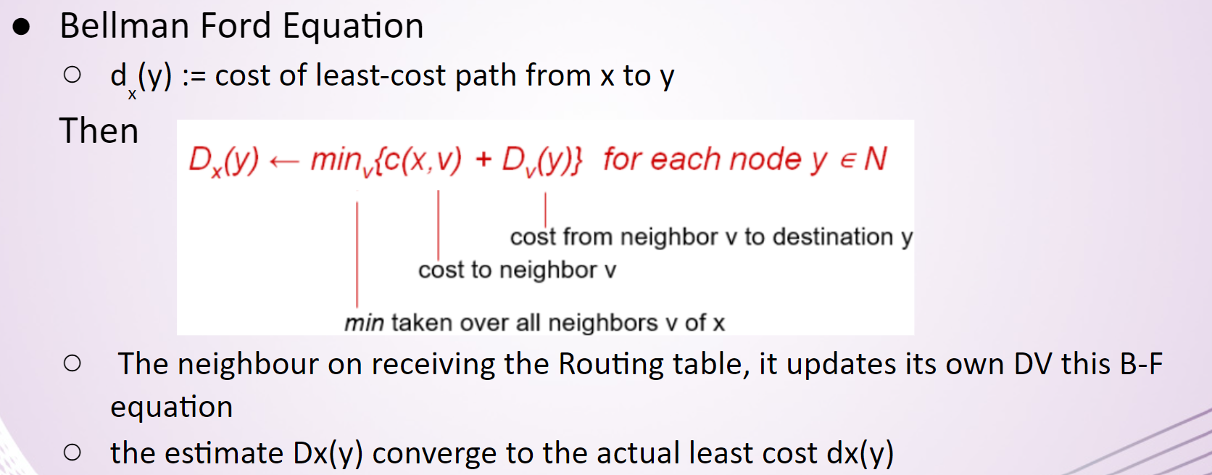

Slide 90
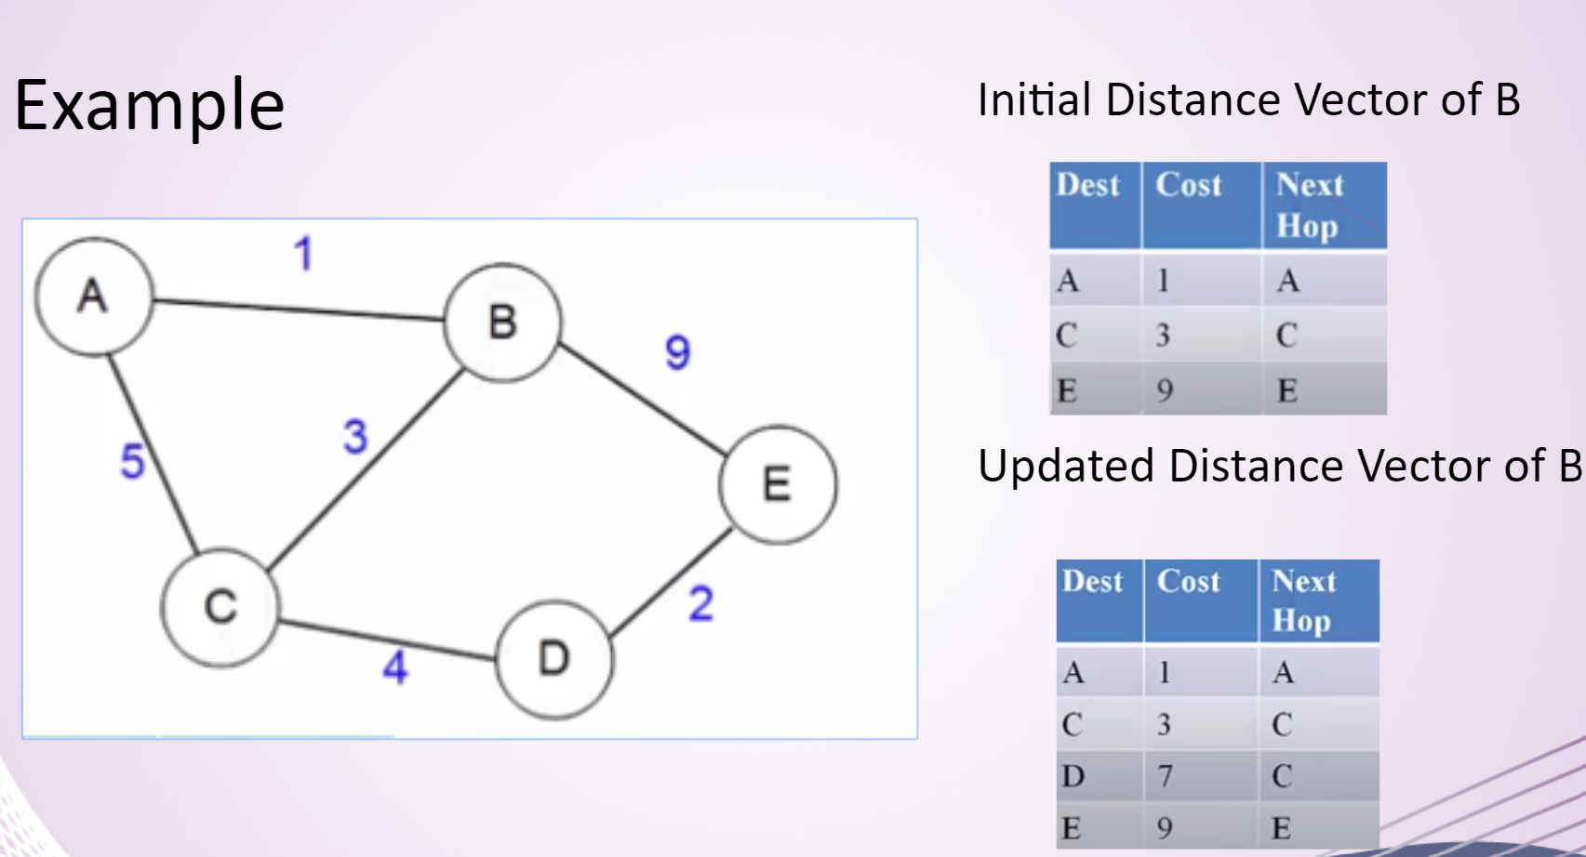

Slide 91
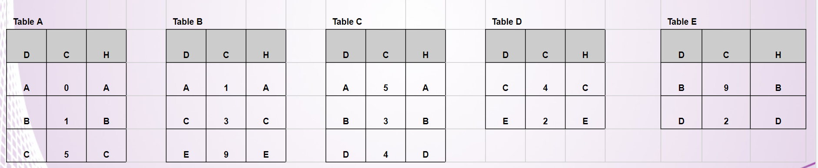

Slide 92
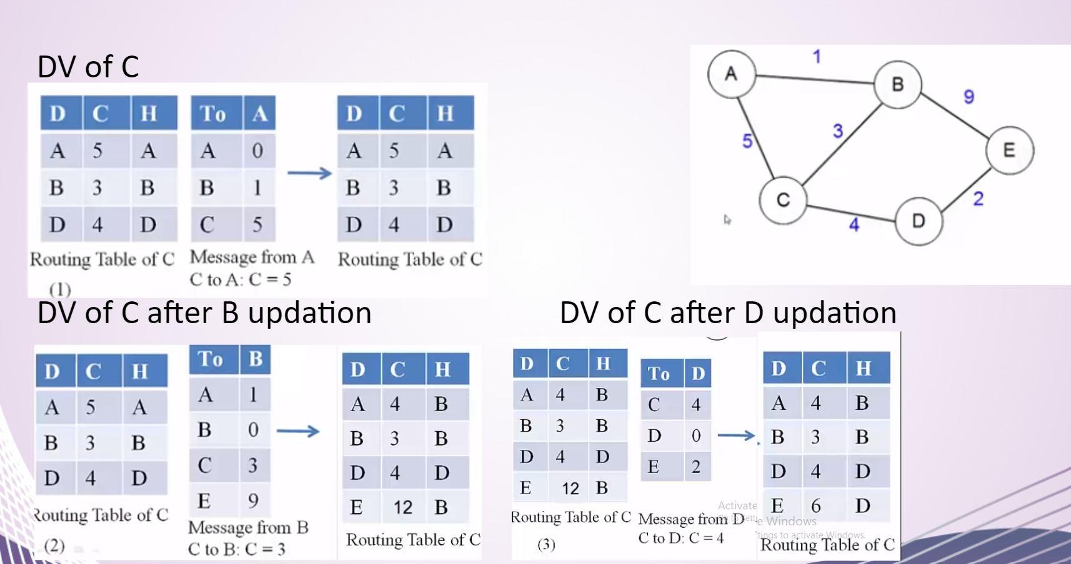

Slide 93
Link state routing
Link state routing is a technique in which each router shares the knowledge of its neighborhood with every other router in the internetwork.
The three keys to understand the Link State Routing algorithm:
Knowledge about the neighborhood: Instead of sending its routing table, a router sends the information about its neighborhood only. A router broadcast its identities and cost of the directly attached links to other routers.
Flooding: Each router sends the information to every other router on the internetwork except its neighbors. This process is known as Flooding. Every router that receives the packet sends the copies to all its neighbors. Finally, each and every router receives a copy of the same information.
Information sharing: A router sends the information to every other router only when the change occurs in the information.

Slide 94
Link State Routing has two phases:
Reliable Flooding
Initial state: Each node knows the cost of its neighbors.
Final state: Each node knows the entire graph.
Route Calculation
Each node uses Dijkstra's algorithm on the graph to calculate the optimal routes to all nodes.
The Link state routing algorithm is also known as Dijkstra's algorithm which is used to find the shortest path from one node to every other node in the network.
The Dijkstra's algorithm is an iterative, and it has the property that after k^{th} iteration of the algorithm, the least cost paths are well known for k destination nodes.

Slide 95
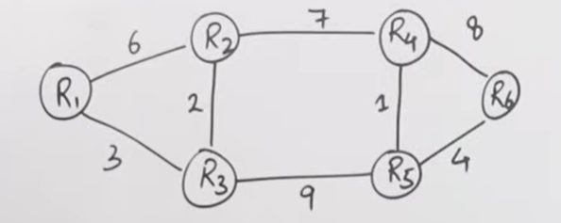
Link state routing

Slide 96
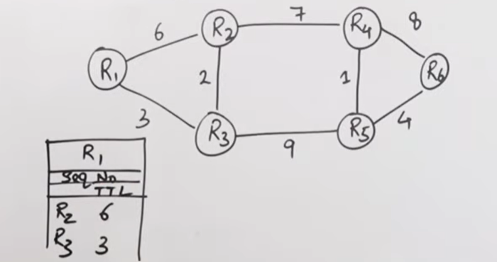

Slide 97
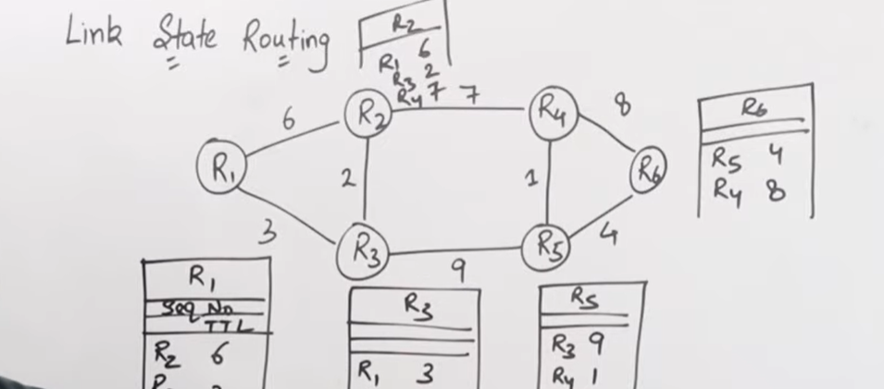

Slide 98
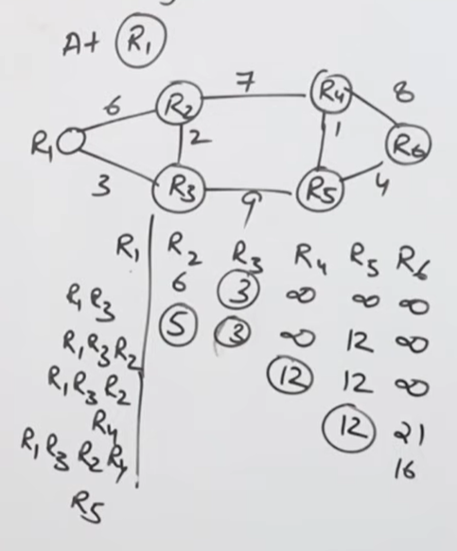
The Dijkstra's algorithm

Slide 99
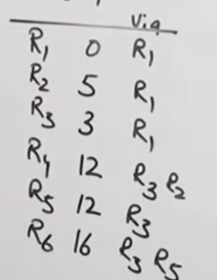

Slide 100
Distance Vector routing protocol
It is a dynamic routing algorithm in which each router computes a distance between itself and each possible destination i.e. its immediate neighbors.
The router shares its knowledge about the whole network to its neighbors and accordingly updates the table based on its neighbors.
The sharing of information with the neighbors takes place at regular intervals.
It makes use of Bellman-Ford Algorithm for making routing tables.
Link state routing protocol
It is a dynamic routing algorithm in which each router shares knowledge of its neighbors with every other router in the network.
A router sends its information about its neighbors only to all the routers through flooding.
Information sharing takes place only whenever there is a change.
It makes use of Dijkstra’s Algorithm for making routing tables.

Slide 101
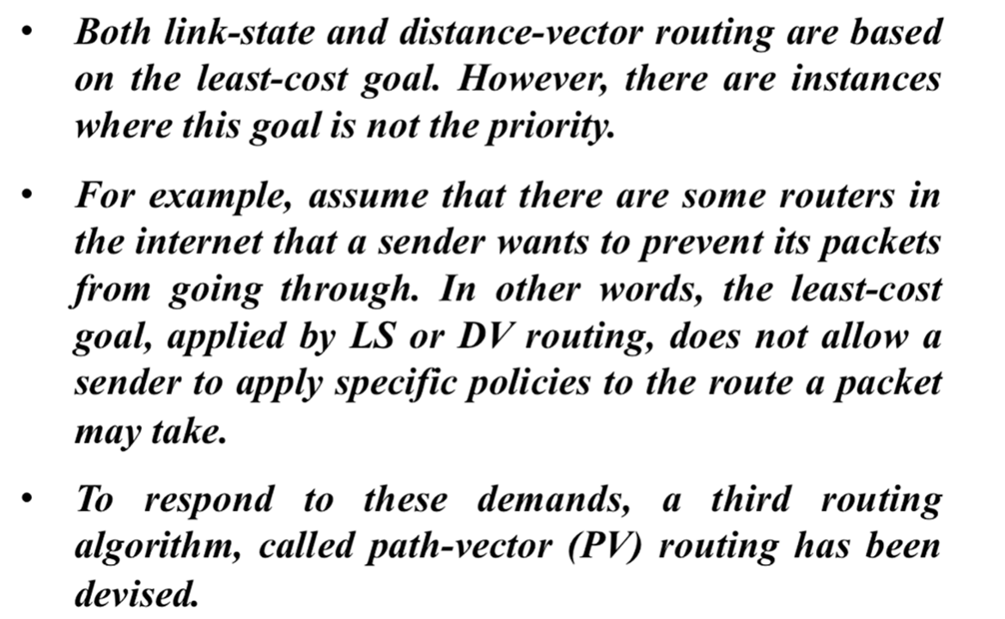
Path Vector Routing

Slide 102
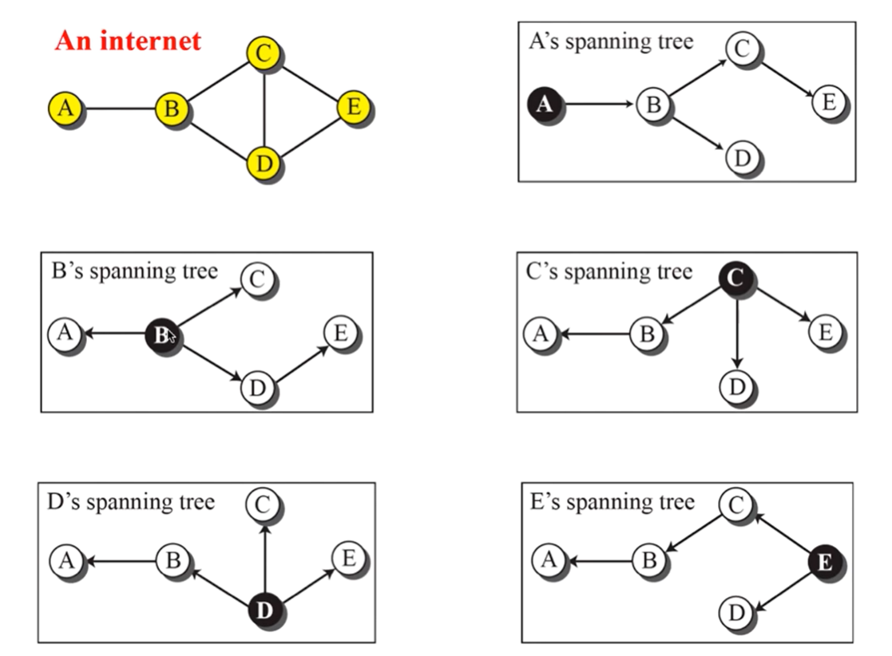

Slide 103


Slide 104

Updating path vectors

Slide 105

Protocols –RIP,OSPF,BGP

Slide 106
RIP protocol
RIP stands for Routing Information Protocol. RIP is an intra-domain routing protocol used within an autonomous system. Here, intra-domain means routing the packets in a defined domain, for example, web browsing within an institutional area.
RIP is based on the distance vector-based strategy, so we consider the entire structure as a graph where nodes are the routers, and the links are the networks.
The cost metric is the number of hops to reach the destination. The number of hops available in a network would be the cost. The hop count is the number of networks required to reach the destination.
In RIP, infinity is defined as 16, which means that the RIP is useful for smaller networks or small autonomous systems. The maximum number of hops that RIP can contain is 15 hops, i.e., it should not have more than 15 hops as 16 is infinity.

Slide 107

How is hop count determined?
When the router sends the packet to the network segment, then it is counted as a single hop.

Slide 108

RIP Message Format

Slide 109
Command: It is an 8-bit field that is used for request or reply. The value of the request is 1, and the value of the reply is 2.
Version: Here, version means that which version of the protocol we are using. Suppose we are using the protocol of version1, then we put the 1 in this field.
Reserved: This is a reserved field, so it is filled with zeroes.
Family: It is a 16-bit field. As we are using the TCP/IP family, so we put 2 value in this field.
Network Address: It is defined as 14 bytes field. If we use the IPv4 version, then we use 4 bytes, and the other 10 bytes are all zeroes.
Distance: The distance field specifies the hop count, i.e., the number of hops used to reach the destination.

Slide 110



How does the RIP work?

Slide 111
The following are the disadvantages of RIP:
The RIP is a classful routing protocol, so it does not support the VLSM (Variable Length Subnet Mask). The classful routing protocol is a protocol that does not include the subnet mask information in the routing updates.
It broadcasts the routing updates to the entire network that creates a lot of traffic. In RIP, the routing table updates every 30 seconds. Whenever the updates occur, it sends the copy of the update to all the neighbors except the one that has caused the update. The sending of updates to all the neighbors creates a lot of traffic. This rule is known as a split-horizon rule.
It faces a problem of Slow convergence. Whenever the router or link fails, then it often takes minutes to stabilize or take an alternative route; This problem is known as Slow convergence.
RIP supports maximum 15 hops which means that the maximum 16 hops can be configured in a RIP

Slide 112
How RIP updates its Routing table
The following timers are used to update the routing table:
RIP update timer : 30 sec
The routers configured with RIP send their updates to all the neighboring routers every 30 seconds.
RIP Invalid timer : 180 sec
The RIP invalid timer is 180 seconds, which means that if the router is disconnected from the network or some link goes down, then the neighbor router will wait for 180 seconds to take the update. If it does not receive the update within 180 seconds, then it will mark the particular route as not reachable.
RIP Flush timer : 240 sec
The RIP flush timer is 240 second which is almost equal to 4 min means that if the router does not receive the update within 240 seconds then the neighbor route will remove that particular route from the routing table which is a very slow process as 4 minutes is a long time to wait.

Slide 113
The following are the advantages of a RIP protocol:
It is easy to configure
It has less complexity
The CPU utilization is less.

Slide 114
OSPF
The OSPF stands for Open Shortest Path First.
It is a widely used and supported routing protocol. It is an intradomain protocol, which means that it is used within an area or a network.
It is an interior gateway protocol that has been designed within a single autonomous system.
It is based on a link-state routing algorithm in which each router contains the information of every domain, and based on this information, it determines the shortest path.
The goal of routing is to learn routes. The OSPF achieves by learning about every router and subnet within the entire network. Every router contains the same information about the network.
The way the router learns this information by sending LSA (Link State Advertisements). These LSAs contain information about every router, subnet, and other networking information

Slide 115

OSPF divides the autonomous systems into areas where the area is a collection of networks, hosts, and routers. Like internet service providers divide the internet into a different autonomous system for easy management and OSPF further divides the autonomous systems into Areas.
Routers that exist inside the area flood the area with routing information
In Area, the special router also exists. The special routers are those that are present at the border of an area, and these special routers are known as Area Border Routers. This router summarizes the information about an area and shares the information with other areas.

Slide 116
How does OSPF work?
There are three steps that can explain the working of OSPF:
Step 1: The first step is to become OSPF neighbors. The two connecting routers running OSPF on the same link creates a neighbor relationship.
Step 2: The second step is to exchange database information. After becoming the neighbors, the two routers exchange the LSDB information with each other.
Step 3: The third step is to choose the best route. Once the LSDB information has been exchanged with each other, the router chooses the best route to be added to a routing table based on the calculation of SPF.

Slide 117

OSPF Message Format

Slide 118
Version: It is an 8-bit field that specifies the OSPF protocol version.
Type: It is an 8-bit field. It specifies the type of the OSPF packet.
Message: It is a 16-bit field that defines the total length of the message, including the header. Therefore, the total length is equal to the sum of the length of the message and header.
Source IP address: It defines the address from which the packets are sent. It is a sending routing IP address.
Area identification: It defines the area within which the routing takes place.
Checksum: It is used for error correction and error detection.
Authentication type: There are two types of authentication, i.e., 0 and 1. Here, 0 means for none that specifies no authentication is available and 1 means for pwd that specifies the password-based authentication.
Authentication: It is a 32-bit field that contains the actual value of the authentication data.

Slide 119
BGP
Border Gateway Protocol
It is an interdomain routing protocol, and it uses the path-vector routing. It is a gateway protocol that is used to exchange routing information among the autonomous system on the internet.
There are many versions of BGP, such as:
BGP version 1: This version was released in 1989 and is defined in RFC 1105.
BGP version 2: It was defined in RFC 1163.
BGP version 3: It was defined in RFC 1267.
BGP version 4: It is the current version of BGP defined in RFC 1771.
The BGP is the only protocol that is running on the internet backbone or used to exchange the routes between two different autonomous number systems. Internet service providers use the BGP protocol to control all the routing information.

Slide 120


Slide 121
BGP Features
Open standard
It is a standard protocol which can run on any window device.
Exterior Gateway Protocol
It is an exterior gateway protocol that is used to exchange the routing information between two
or more autonomous system numbers.
InterAS-domain routing
It is specially designed for inter-domain routing, where interAS-domain routing means exchanging
the routing information between two or more autonomous number system.
Supports internet
It is the only protocol that operates on the internet backbone.
Classless
It is a classless protocol.

Slide 122
Path vector protocol
The BGP is a path vector protocol. Here, path vector is a method of sending the routes
along with routing information.
Configure neighborhood relationship
It sends updates to configure the neighborhood relationship manually. Suppose there are two routers R1 and R2. Then, R1 has to send the configure command saying that you are my neighbor On the other side, R2 also has to send the configure command to R1, saying that R1 is a neighbor of R1. If both the configure commands match, then the neighborhood relationship will get developed between two routers.
Application layer protocol
It is an application layer protocol and uses TCP protocol for reliability.
Metric
It has lots of attributes like weight attribute, origin, etc. BGP supports a very rich number of attributes that can affect the path manipulation process.

Slide 123
IPv6 Protocol
IPv4 produces 4 billion addresses, and the developers think that these addresses are enough, but they were wrong.
IPv6 is the next generation of IP addresses. The main difference between IPv4 and IPv6 is the address size of IP addresses
. The IPv4 is a 32-bit address, whereas IPv6 is a 128-bit hexadecimal address.
IPv6 provides a large address space, and it contains a simple header as compared to IPv4.
It provides transition strategies that convert IPv4 into IPv6, and these strategies are as follows:
Dual stacking: It allows us to have both the versions, i.e., IPv4 and IPv6, on the same device.
Tunneling: In this approach, all the users have IPv6 communicates with an IPv4 network to reach
IPv6.
Network Address Translation: The translation allows the communication between the hosts
having a different version of IP.

Slide 124


Slide 125


Slide 126


Slide 127
THE END

